Slide 1

FDAData Analysis & Visualization for Data Analysis & Visualization for FDA
Made By :-
Archit Tripathi
ABADS-15

Slide 2
Overview And Key Metrics
Project Overview & Key Metrics
Project Objective:
FDA intends to carryout analysis of data gathered over the years for approval of drugs in the United Stated of America. The will help identify the trends of drug approval process and other related details
2. Key Metrics:
Identifying approval trends over time
Analysing product segmentation based on marketing status
Evaluating drug categories by dosage form
Exploring therapeutic classes and their approval trends

Slide 3
Annual Drug Approval Trends :
Over the years the general trend of drug approval has been increasing with few sudden rise and upsets in between
Year 1980s and post 1990s the trend has been on the rise for approvals
The biggest increase was in year 1980 after a drop in year 1979 and the biggest increase in approval number. However the drop was also sudden in 1990s with gradual increase till 2020. Notably the approval count has drop again after 2020 which could be due to COVID 19.

Slide 4
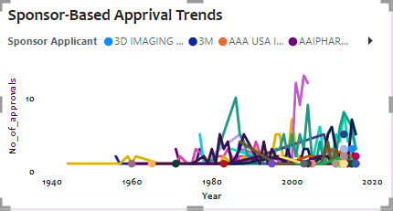
Approval Trends
While the trend in no of applications from each sponsor has been varied over the years, ACTAVIS ELIZABETH has remained on the higher side. Specially in 1996 with 10 applications
Another sponsor – ABLE has been in the fore front post 2000 with ACTAVIS
Highest number of applications has been in year 2000, 2001, 1996 and post 2010

Slide 5
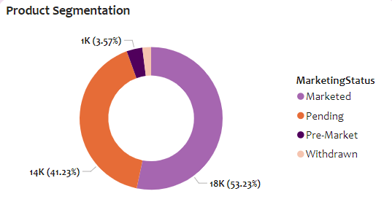
Product Segmentation
More than 80% of the products are in the Marketed segment
There are close to 2% of products that are still there which are withdrawn from the Marketing
The second largest segment of products are pre-marketed as well.

Slide 6
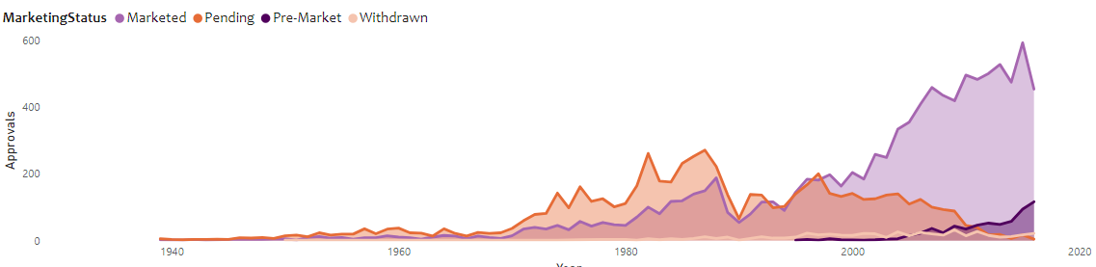
Marketing Status Segmentation
The trend for marketed products has increase and largely from later 1990s and early 2000’s. The same has increase suddenly post 2000
The sudden increase in marketed products is due to introduction of premarket stage only late 1900s and early 2000s.
The pending and withdrawals has been the lower side except from year 1970 to 1985s

Slide 7
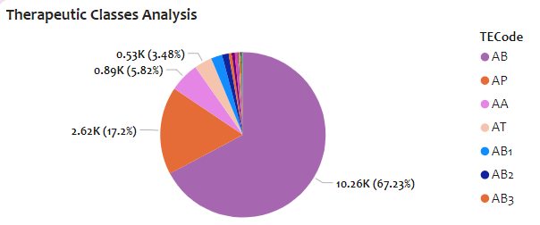
Therapeutic Classes Analysis
The highest approval rates are for AB and AB1 Type of TE Codes
AB takes the majority of portion of approval with more than 65% of approvals

Slide 8
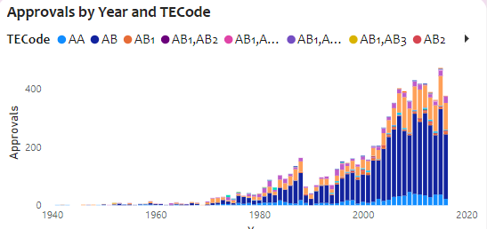
Therapeutic Classes Analysis
Over the period the AB and AP has remained on top for approvals in terms of therapeutic classes
One notable trend is that AP’s popularity for approval as increase drastically and likely to match with AB over next few years

Slide 9
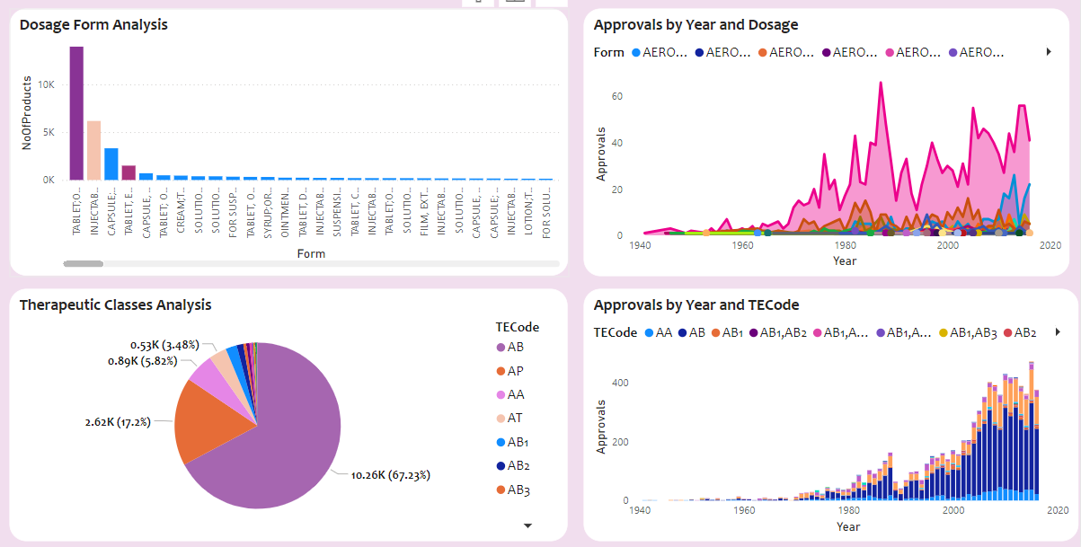
Summary
Out of total 15,000 approval for 34,000 products over last 90 years, the approval trends has been on the rise except few major exceptions in year 1990 and 1980.
After the introduction of pre-marketed stage, the product marketed status has increased drastically with lesser % of products being withdrawn or pending
The focus should be on reducing the number of products being in pending status.
FDA should focus on increasing more resources in products with dosage type Tablet, Injections and Capsules in order to ensure efficient approvals

Slide 10
THANKS

